Slide 1

Don’t build training.. Just auto-generate it.
Alven Capital - 6th Nov 2018
CEO & co-founder Simon Egenfeldt-Nielsen | sen@sentio.net
Head of Development & Research, Damian Brown | djb@sentio.net

Slide 2
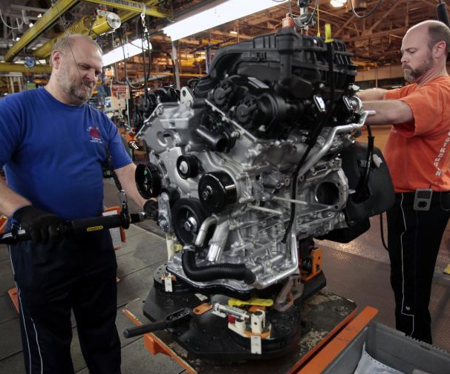
PROBLEM
Training in manufacturing unchanged for generations. Operators at the line still learn F2F.
Costly to deliver
Inconsistent delivery
Non-flexible usage
Scales poorly

Slide 3
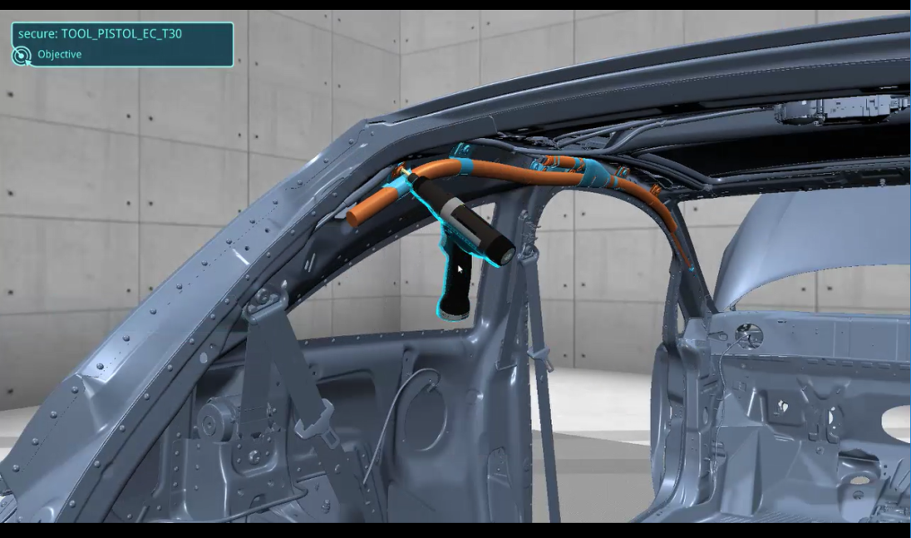
OUR SOLUTION: VISTRA
A fully automated interactive 3D training simulation based on existing engineering data for operators. Many use cases: onboarding, new variant, quality issues, compliance, retraining, new plant ayouts
Digital Twin (Industry 4.0)
VISTRA Automation (10 mouse clicks | 40 secs.)
VISTRA Training & Assistance

Slide 4
TRACTION
BMW: ”Looks like you build it for us”
GM: “Been trying to do this for 15 years without success, but now you have shown us that it IS possible.”
Honda: "If you can load our data that is huge"
Notes:
Based on dialogue with customers!

Slide 5




TRACTION
$
Real Revenue (+380.000 EUR) (1.11.2018)
6 Paying customers (eg. Opel and BMW)
9 Pilots delivered (eg. PSA and Vestas)
1 Full plant launch (800 operators)
5 Smart factory demonstrator partners
3 eco-system partner (eg. Dassault)

Slide 6
MARKET
MANUFACTURING OPERATORS
Growth
Market Size (training)
+57 mio. manufacturing operators
(developed countries*) (yearly growing +2,8%)
EUR 3.54Billions (excl. other use case)
Cost savings pr. operator: 125 EUR
Our price pr. operator: 62 EUR
(Competitor price: 150 EUR)
+ Digitalisation in factories growing
* NA, EU, Japan and Korea
SOURCES: Deloitte, BCG, OICA, MFI, NACE, BLS

Slide 7
BUSINESS MODEL
SaaS, pr. operator, integration, yearly license
Integration package: 35.000 EUR
License pr. year: 50.000 EUR
Pr. plant (average 1000 operators)

Slide 8
UNFAIR ADVANTAGE
DATA TIE-IN
THROUGH OUR DATA MAPPING
UNIQUE
AUTOMATION

Slide 9
COMMERCIAL STRATEGY
OEM Direct HQ: We approach directly HQ stakeholders around I4.0 and PLM that are looking for ways to leverage their huge investments in digital twin. We tie-in centrally, and then slowly rolls out globally to all plants. Advanced in this strategy with PSA, BMW and Opel. Started with JLR and Honda NA.
PLM partnerships: We pursue partnership with especially Dassault and TeamCenter as it provides us access and credibility with customers. In long term it can also allow us access to data that non-partners don’t have.
Integrator partnerships: There exist numerous companies that already deliver different solution to OEMS, and they can also offer our solution. We are currently in early partnerships talks in India and Mexico.

Slide 10

KPI
CAC: €32.800 (w. delivery)
CAC-R: 5 month (w. delivery)
LTV: €535.000
Profit-margin: 50%
Burnrate: €20.000
Runway: 6 months

Slide 11
COMPETITIORS
High RoI
SENTIO
5 FTEs
Denmark
OPEL, Vestas, BMW
N-Grain
28 FTEs
Canada
Raytheon, Lockheed
Manual Projects
Vizendo
30 FTEs
Sweden
Volvo, JLR, GM, VW
AutomationTool
Cortona3D
13 FTEs
Ireland/Russia
BMW, Ford, VW
LivingSolids
9 FTEs
Germany
VW, Daimler
Low RoI

Slide 12
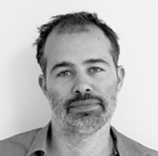
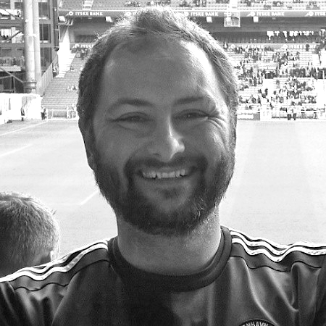
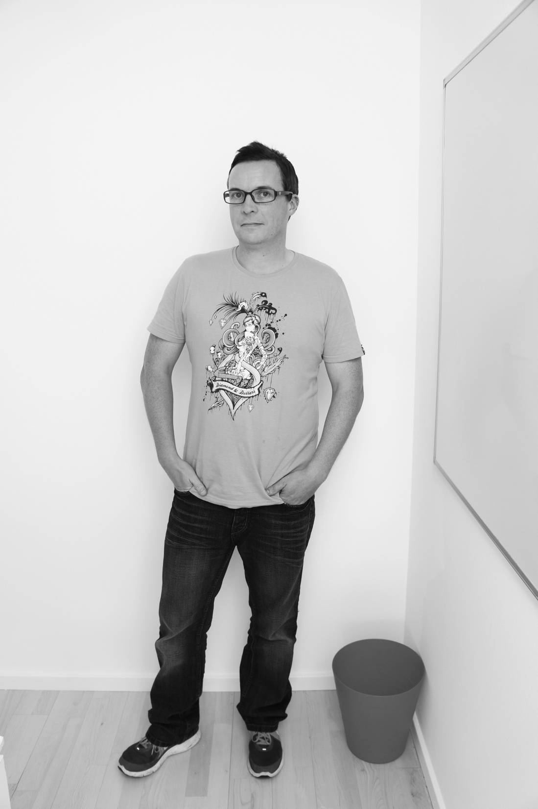
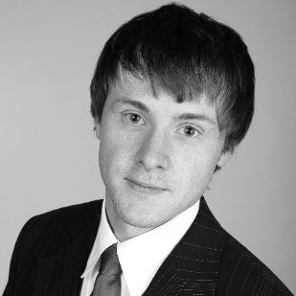
TEAM
Simon Egenfeldt-Nielsen (DK)
CEO
Strategy, biz dev and partnerships.
+15 years experience making Serious Games Interactive among category leaders with two digit DKK mio. revenue.
Multiple start-ups in DK.
Thomas Gravgaard (DK)
CTO
Back-end, Unity3D, enterprise
+20 years experience in developing software, serious games and simulation applications for critical areas.
Past start-ups in Data service & games
Damian Brown (UK)
CPO
Product vision & development, team lead.
+15 years experience in making digital learning and technology projects across Europe.
Past start-up in UK
Dominic Goresky (DE)
Country Manager Germany
German market, technical integration and partnerships
Head of SmartFactory Park Biel and leading researcher within Industry 4.0.
Start-ups in Germany
PhD. MA Psychology
BSc, Computer science
BSc. Arts
PhD, Dr.-Ing.

Slide 13
Financial overview (EUR, thousands)
EUR (thousands) | 2016/17 | 2017/18 | 2018/2019 | 2019/2020 | 2020/2021
Commercial revenue | 14 | 50 | 600* | 1.800 | 5.400
Support grants | 89 | 90 | 0 | 0 | 0
TOTAL REVENUE | 103 | 140 | 600 | 1.800 | 5.400
Development cost | 201 | 441 | 680 | 880 | 1.080
Sales & marketing cost | 39 | 280 | 480 | 680 | 820
Fixed cost & overhead | 30 | 60 | 120 | 200 | 280
TOTAL COST | 270 | 581 | 1.280 | 1.760 | 2.180
Employees (FTE) | 3,5 | 7* | 16 | 21 | 27
EBITDA | -556 | -441 | -620 | +40 | +3.210
EBIDTA (as % of revenue) | - | - | - | 2% | 59%
* Depends on when we get funding to accelerate sales.

Slide 14
Funding, investment and valuation
$
Funding achieved EUR965.000
Pre-money valuation EUR5.400.000
Investment
Grow sales operations
Dedicated delivery organisation
Patience and robustness to build tie-in
Investment range EUR810.000-1.080.000

Slide 15
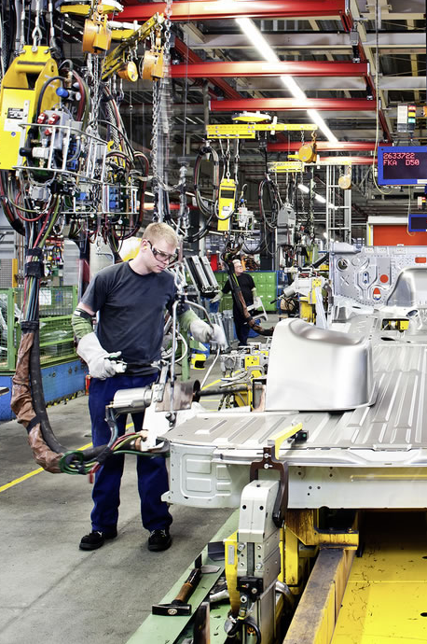
Manufacturing is a slow moving industry with long cycles but ones you are in there is a attractive constant revenue stream
More information

www.sentio.net
Get in touch
✉
info@sentio.net

